Slide 1

Telephone Etiquette
Sayli S. Bapat
Assistant Professor, Department of Management, Tilak Maharashtra Vidyapeeth

Slide 2
HOW DO WE TALK???
WHETHER AT OFFICE OR AT HOME...
It is important to be fully aware of how we talk or behave over the phone.

Slide 3
Answering the Telephone
Pick up the phone in three rings. More than three rings... signals chaos in your office or inattentiveness.
Greet the caller, e.g. Good Morning / Namaste. Good manners show that you respect the caller.
Give your name. This is a courtesy that serves to personalize the customer service experience as well as allowing the customer to hold you accountable for your level of service.

Slide 4
Phases of Professional Calling
Opening the Call with Greetings
Building Rapport & Identifying the need
Collecting/ Verifying information
Providing information, Alternative solutions
Summarize and close the call

Slide 5
Tone of Voice

Slide 6
Different Phone Call Situations – Answering a Call
Before answering a call, be prepared
Keep a pen/pencil and notepad ready
Have your Computer on
Ensure, there is no noise in the background

Slide 7
While Answering the call -
Answer the call within three rings
Greet the Caller
Give the name of the company/ department
Focus your attention on the caller
Ask them how you can help them

Slide 8
Before placing a call -
Know the name of the person you want to reach and how to pronounce it.
Know what you need to say before placing the call brief and effective.
Verify the phone number before calling.

Slide 9
In Placing the call -
State your name along with the name of the person you want to speak with.
Ask the caller if it is convenient to talk.
State your business as clearly and as politely as you can.
Be specific.....do not give wavering answers.
Insist on calling back if the connection is faulty.

Slide 10
Ending the call -
Make sure that the caller has no more queries or messages.
Use Goodbye or Thank you for calling to end the conversation.
Make sure the caller drops down the receiver before you. This prevents the feeling that you may have cut them off intentionally.

Slide 11
Transferring Calls -
Transfer the calls only if they are not meant for you.
Ask permission to transfer the calls and explain the reason for transfer.
Let the caller know the name of the department and person you are transferring the call to.
Be sure you are transferring the calls to the proper person or department.
If the caller complains about being transferred, suggest having the call returned instead.
Give the new party any useful information before the transfer.

Slide 12
Transferring calls …. continued
Never transfer the call more than two times.
Know the transfer instructions for the telephone systems so that you do not cut off your caller.

Slide 13
Placing a call on hold -
Make sure it is for a good reason
Ask permission before placing a caller on hold
Return to the line periodically
Ask callers if they want to continue holding
Indicate how long the delay would be
Offer to call the person back if will take long
Never leave the caller on hold for longer than 30 seconds
Be courteous, respectful and professional

Slide 14
Answering Multiple calls -
Place the first caller on hold
Answer the next call
Complete the second call only if it can be completed quickly
Return to the initial call promptly
Provide quality service that meets or exceeds the caller’s expectations

Slide 15
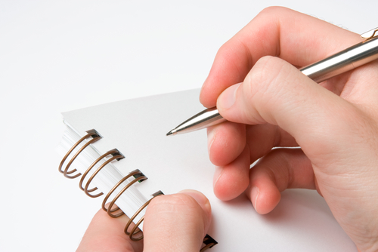
Taking Messages -
Write a message even if the caller indicates to call back
Include the time and date
Write legibly
Verify the caller’s name and phone number by repeating the information
Include as much information as possible to help the recipient return the call
Sign or initial the message slip and deliver the message promptly.

Slide 16
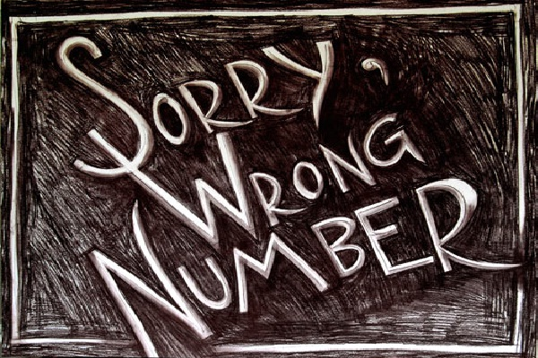
Answering a wrong number call -
Inform the caller politely that he/ she has reached a wrong number.
Suggest the caller to recheck the number and dial again
If the caller is trying to reach a destination that you are familiar with and or have an idea about, do your best to find the number and assist the caller in transferring the call.

Slide 17
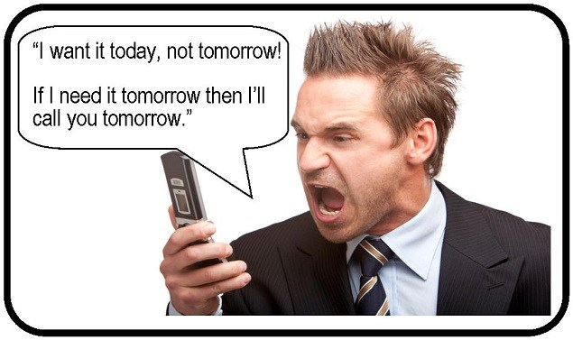
Angry Callers -
Do not allow yourself to get angry when a caller shouts.
Empathize, Express regret for the situation. For e.g. “I am sorry for the inconvenience”.
Find a way to agree with their circumstances. For e.g. “ I understand what you are going through. I’d be upset if that happened to me”.
Suggest alternatives for handling the problem that you have the authority and take responsibility for providing answers to customer.

Slide 18
Telephone Etiquette
Think through exactly what you plan to say and discuss before you place a call.
Always speak in the telephone receiver with an even and low tone of voice, high pitch will sound like shouting.
Be sensitive to the tone of voice
Especially while leaving messages, speak slowly and clearly.
5. Build the habit of turning off the ringer of your cell phone when entering meetings, restaurant, theaters, training class or other places.
6. Do not allow interruptions to occur during conversations.
7. Do not allow yourself to be distracted by other activities while speaking on the phone.

Slide 19
General Tips -
Pick the telephone at the worst before the 3rd ring.
Speak pleasantly and be courteous
Sound alert and active
Be polite irrespective of circumstances
Do not cut the calls abruptly
Avoid slang language
Don’t eat, sip a drink or chew gum while on phone
Introduce both parties to each other before transferring a call
Don’t keep caller on hold for more than 60 seconds
When ending call, ensure there is no unfinished business

